Slide 1
Hello Detectives
We have some work to do

Slide 2
We have a data about
FIFA WORLD CUP FROM 1930 TO 2022

Slide 3

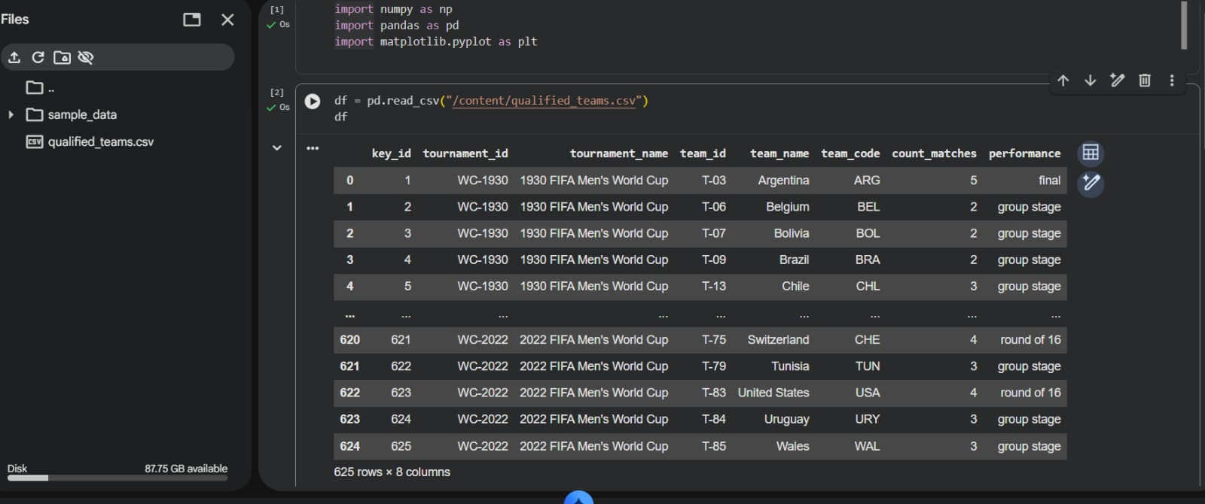
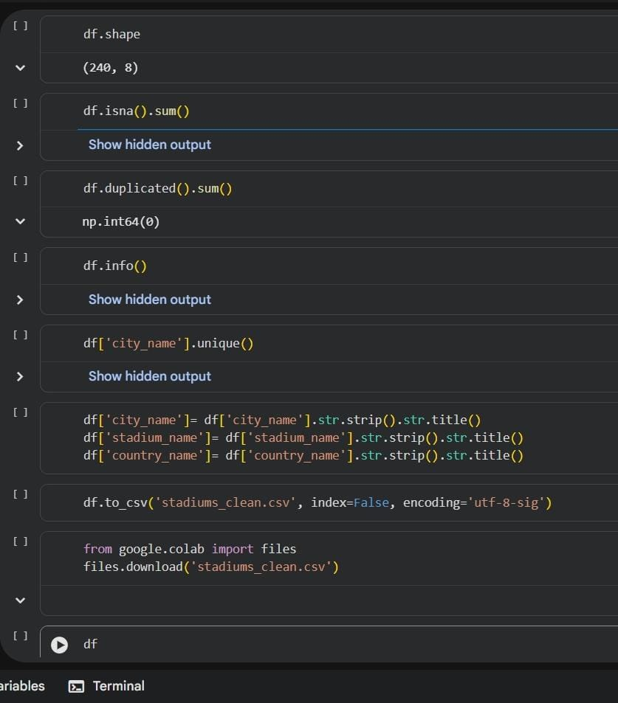
Used Python to clean data

Slide 4
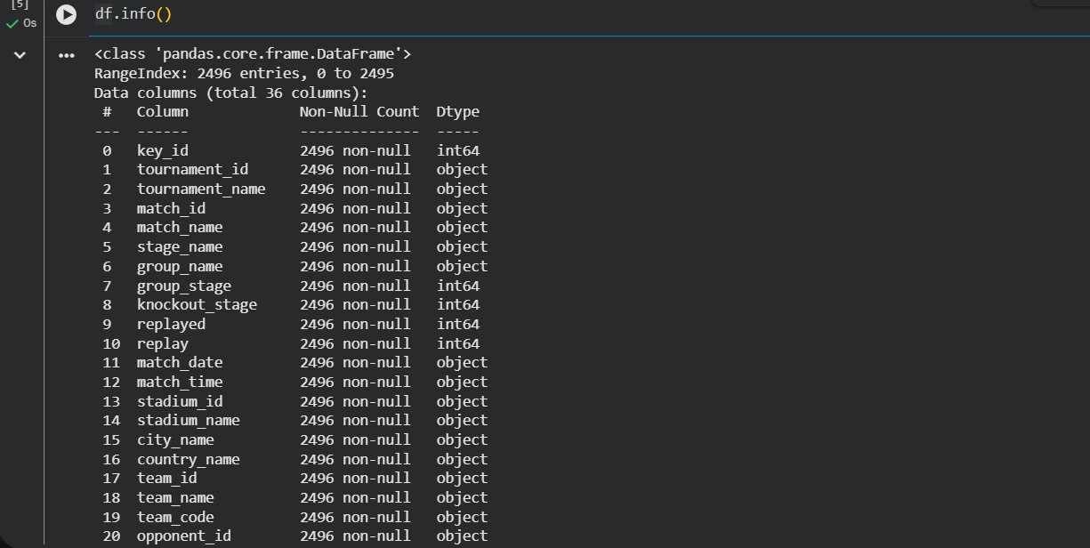
Changed Data types with python

Slide 5
DATA MODELING MADE WITH POWER BI

Slide 6
NOW YOUR TURN
WE HAVE CASES TO SOLVE ABOUT FIFA WORLD CUP TOURNMANTES
THERE ARE MANY FILES IN YOUR OFFICE TRY TO SOLVE CASES THROUGH CLUES

Slide 7

Case 2
Case 3
Case 1
Case 4
Case 5
Case 7
Case 6
Case 8
Case 10
Case 9

Slide 8









CASE 1 : PREDICT WITHOUT HAVING DATA

Slide 9
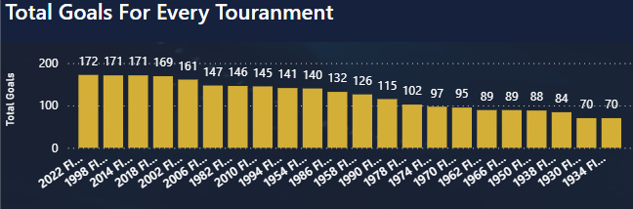
CASE 2 : GOALS PER TOURNAMENT
Through 1930 Until 2022 FIFA WORLD CUP tournaments
No one could beat FIFA QATAR 2022 WORLD CUP in the total number of goals scored in one tournament

Slide 10
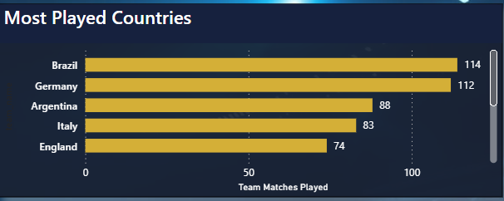
CASE 3 : THE SUITABLE CHART
Brazil and Germany are leading by a wide margin in overall matches played in FWC
Brazil has the lead

Slide 11
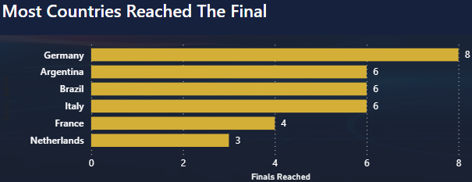
CASE 4 : ITALY RANK IN REACHING FINAL
Among 22 FWC Trophies
Argentina , Brazil, Italy reached the final 6 times and Germany takes the lead by 8 finals appearance

Slide 12
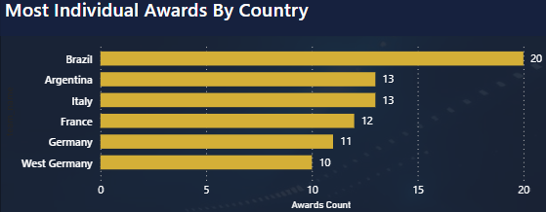
CASE 5 : WHO DOMINATES THE INDIVIDUAL AWARDS?
Most individual awards goes to Brazil

Slide 13
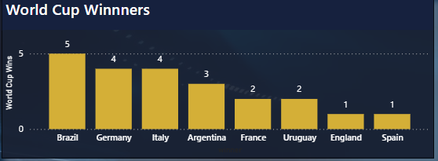
CASE 6 : TITLE HOLDER
Brazil in front of all in the number of FWC titles

Slide 14
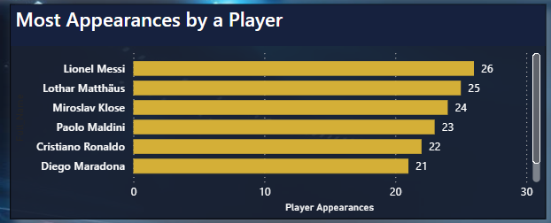
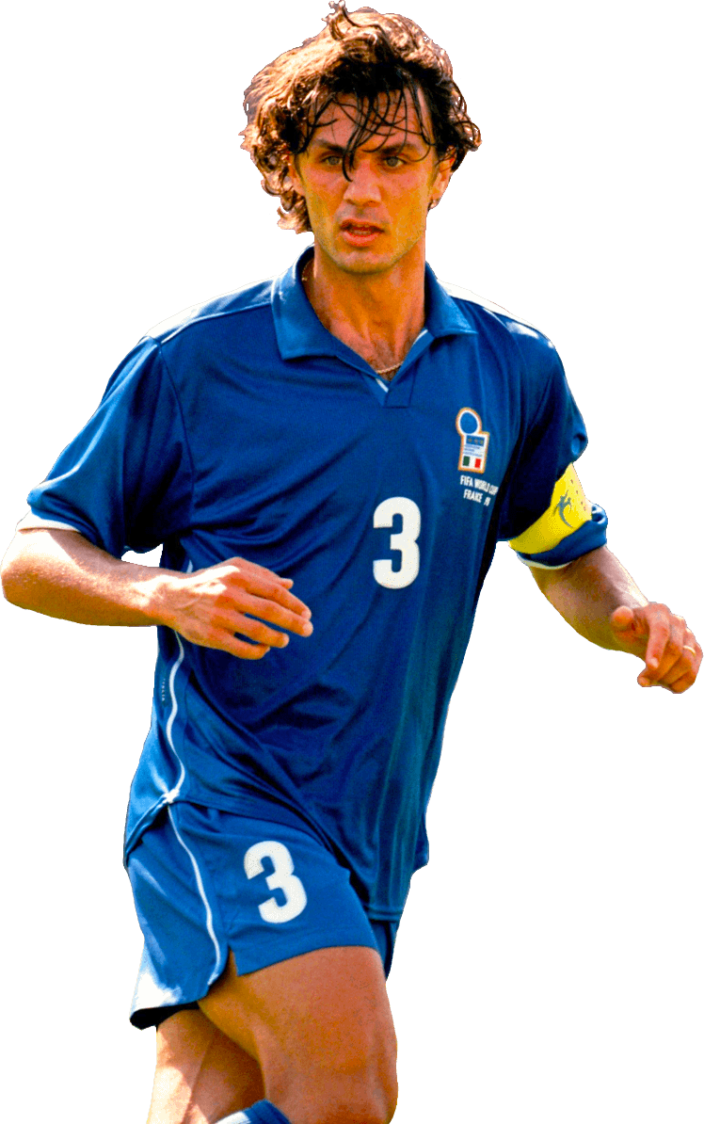


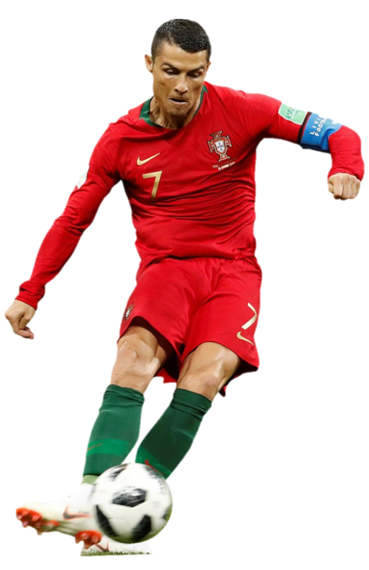
CASE 7 : MOST APPERANCE BY A PLAYER

Slide 15
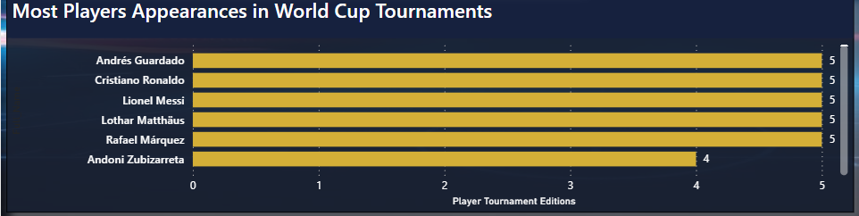
Among 22 FWC Trophies only 5 players contributed in FWC more than others

Slide 16
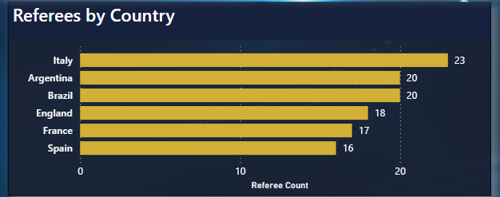
CASE 8 : REFEREES BY COUNTRY
Only Argentina and Brazil compete with Europe countries in sending referees to FWC

Slide 17
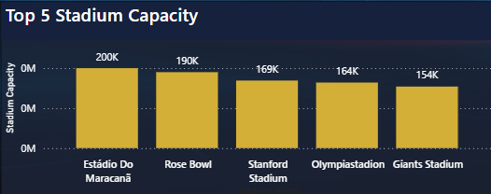
CASE 9 : STADIUM CAPACITY
Maracanã stadium in Brazil is the biggest stadium in capacity all over FWC Tournaments

Slide 18
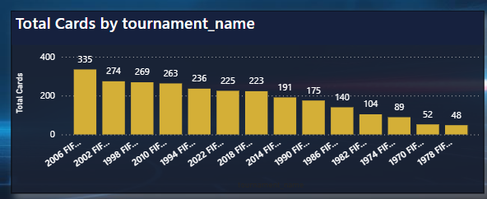
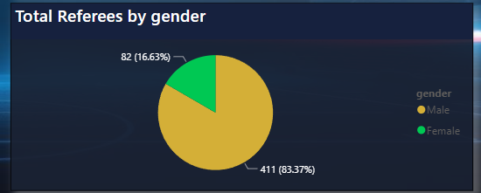
2006 FWC is the most aggressive tournament by 335 card
Among 493 Referees in FWC all time there are only 82 female referee!

Slide 19
CASE 10 : REFEREES GENDER
Among 493 Referees in FWC all time there are only 82 female referee!

Slide 20
This Work Made by:
Mohamed Abdulsalam
Mahmoud Mostafa
Badr Abdulrazek
Ziad Ahmed

Slide 21

Bye
Bye

